Slide 1

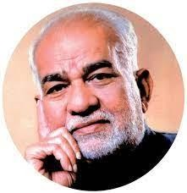
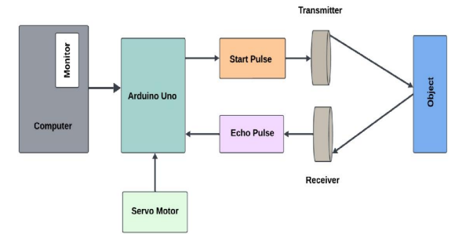
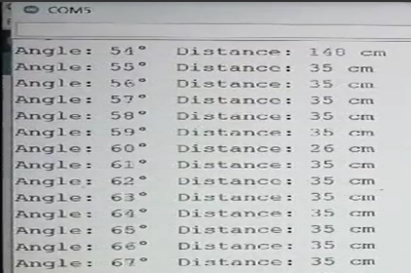
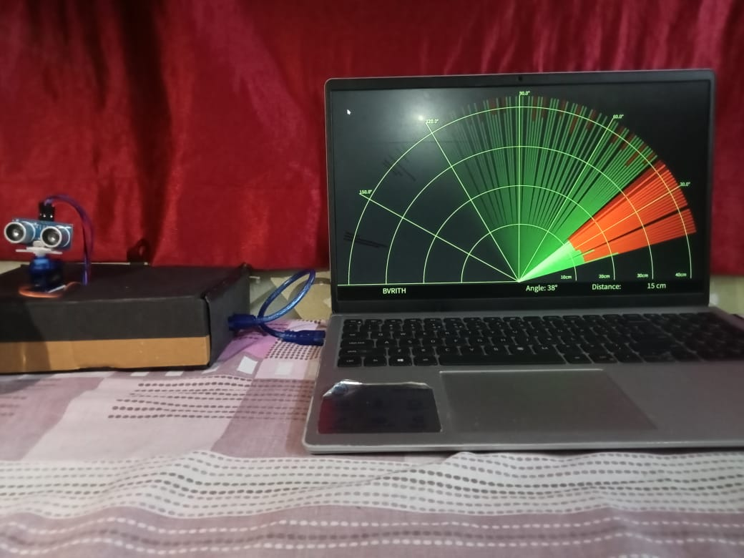
BVRIT HYDERABAD College of Engineering for Women
(UGC Autonomous)
ULTRASONIC RADAR SYSTEM
R&D SHOWCASE 2025
ABSTRACT
The Ultrasonic Radar System utilizes ultrasonic sensors to detect and measure the distance of objects in real time by emitting high-frequency sound waves and analyzing their reflections. This cost-effective and portable solution offers a reliable alternative to LIDAR, enabling non-contact measurement for applications in robotics, automation, and surveillance. Integrating Arduino and processing software, the system provides accurate visualization and enhances intelligent sensing technologies.
Block Diagram
SOCIETAL USE
The Ultrasonic Radar System can enhance safety in automation, robotics, and transportation by enabling accurate object detection and collision avoidance. It supports smart navigation for visually impaired individuals and improves surveillance in public spaces. Its low-cost design makes advanced sensing accessible for educational and community applications.
Results & Analysis
CONCLUSION
In Conclusion, the project successfully achieved its objectives by implementing effective techniques and demonstrating significant results. The approach proved to be efficient and reliable, highlighting its practical applicability. Future work can focus on further optimization and exploring advanced methodologies to enhance performance.
UNIQUENESS
Low-cost alternative | Portable & real-time
Contactless sensing | Arduino integration
METHODOLOGY
Ultrasonic waves are emitted using a sensor and reflected signals from objects are captured to measure distance. Arduino processes the data and visualizes it on a radar-like interface using Processing software. Real-time object detection using ultrasonic waves and Arduino.
REFERENCES
L. Zhang, "Cost-Effective Ultrasonic Radar Systems for Robotics Applications," Robotics and Automation Journal, vol. 10, no. 1, pp. 58-64, Jan. 2022.
T. Rao, "Machine Learning for Object Classification in Ultrasonic Radar Systems," Journal of Artificial Intelligence and Robotics, vol. 13, no. 7, pp. 97-103, Jul. 20
Inventors: Ms. Y Sai Ruthvika |Ms. K Srinithya |Ms. B Leelavanitha|Ms. C Akhila
Faculty Mentor : Dr. Viswanadham Ravuri Email Id: viswanadh.r@bvrithyderabad.edu.in
SDG - 9

